Slide 1

Number plate recognition
S Harish – CB.EN.U4CSE21422
Shreyas Visweshwaran – CB.EN.U4CSE21450
https://github.com/FirefoxSRV/Vehicle-Number-plate-recognition

Slide 2
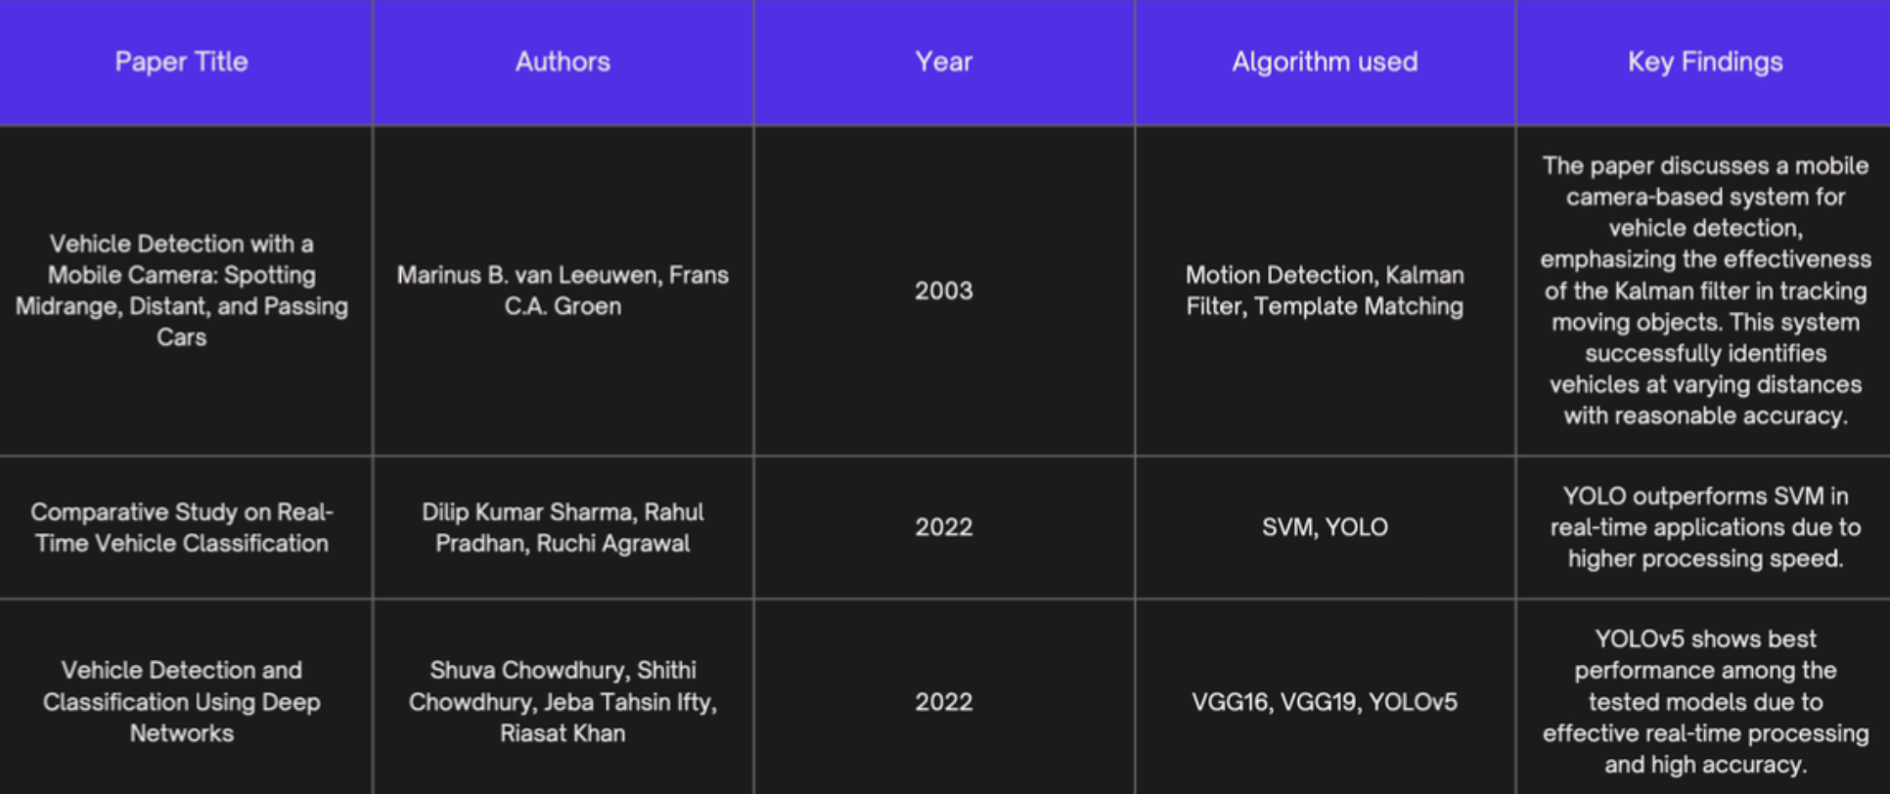
Reference papers

Slide 3

ObjectiveS
Develop a mobile application-based system for automated vehicle type detection and owner information gathering.
Benefits:
Enhances efficiency and security by reducing manual registration efforts.
Provides real-time monitoring of vehicle entries to streamline access management.

Slide 4
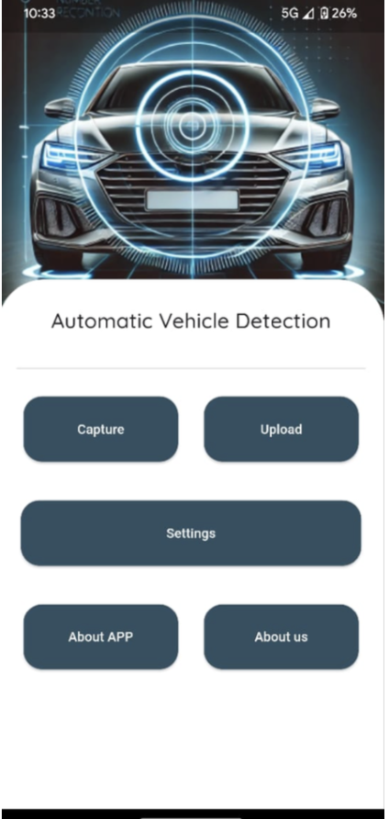
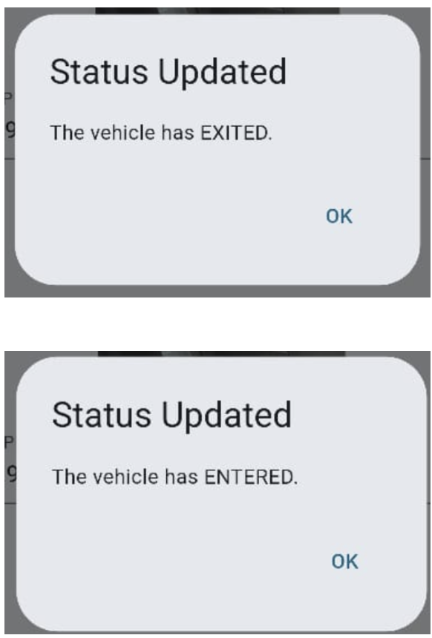
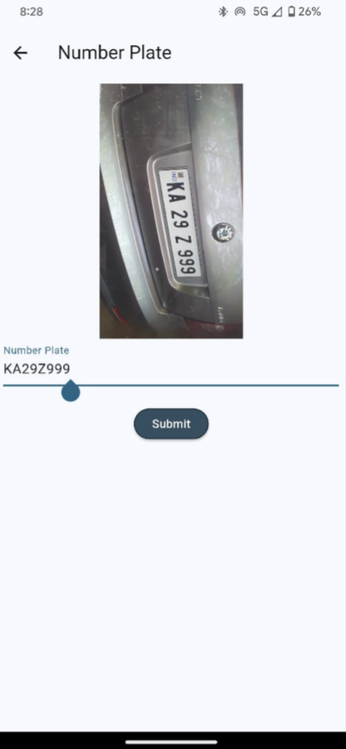
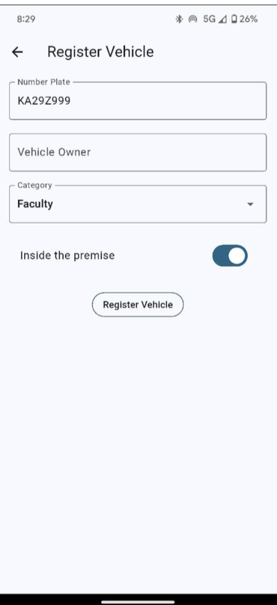
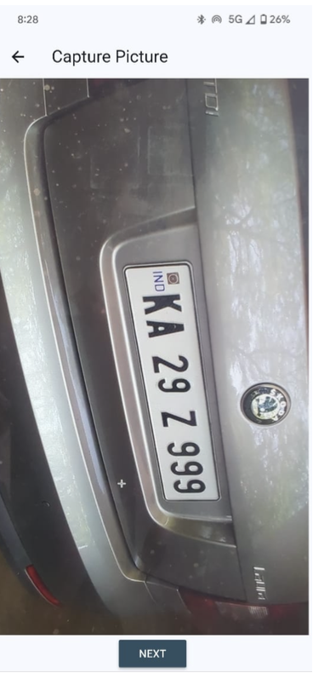
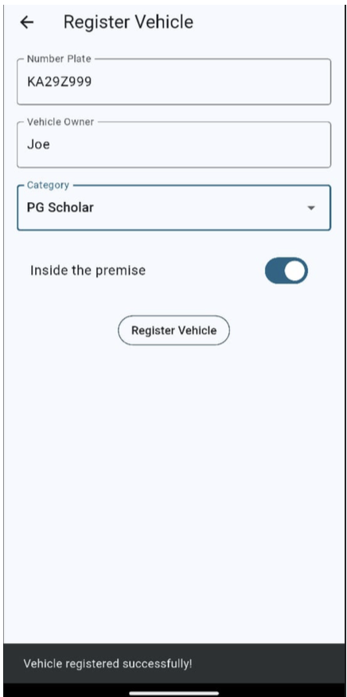

Slide 5
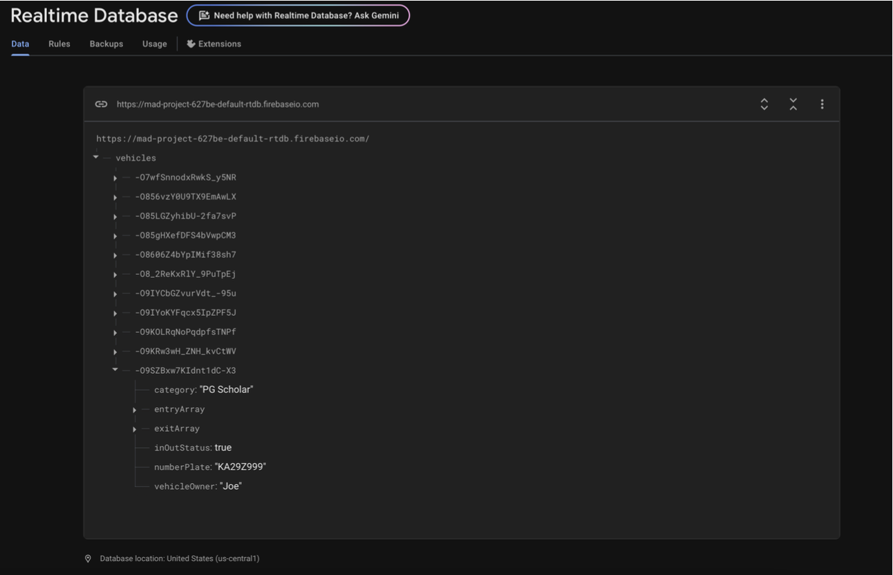
Database

Slide 6
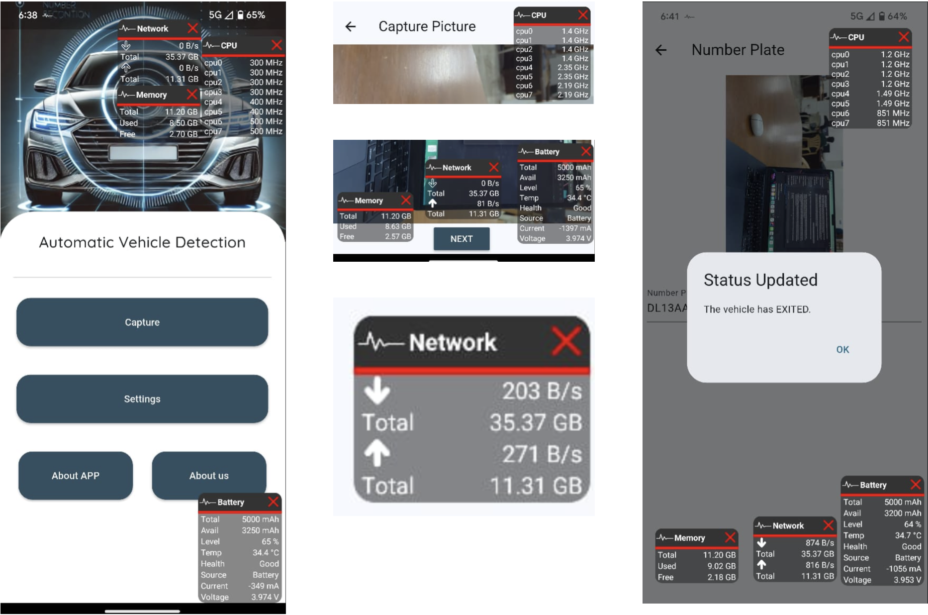

Performance metrics on mobile
We have recorded the performance of the app using the android app “SysFloat”.
Well, we used a different AI model for our app, as yolo v8 was very CPU and Memory intensive. Hence, running edge applications with deep learning models are quite a difficult task….not for the developer, but for the user. There is also a risk of temp rising when these models run.

Slide 7
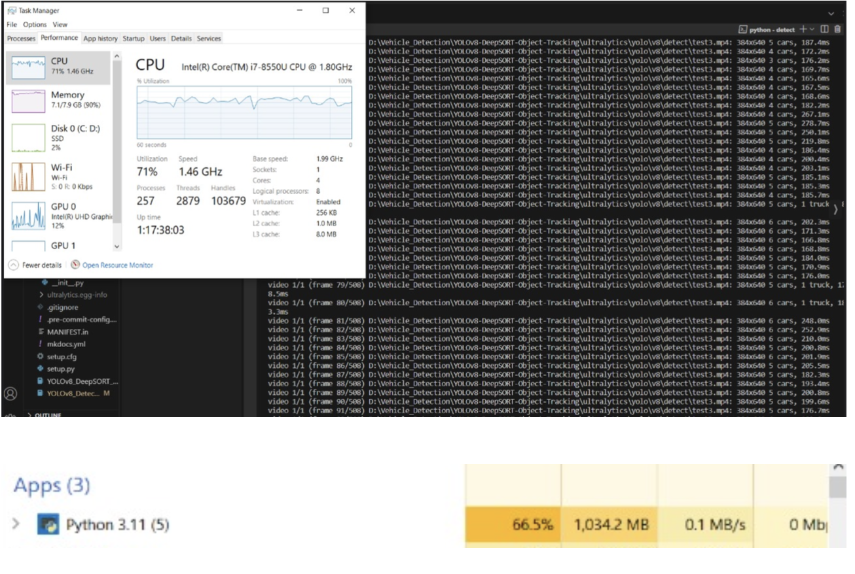
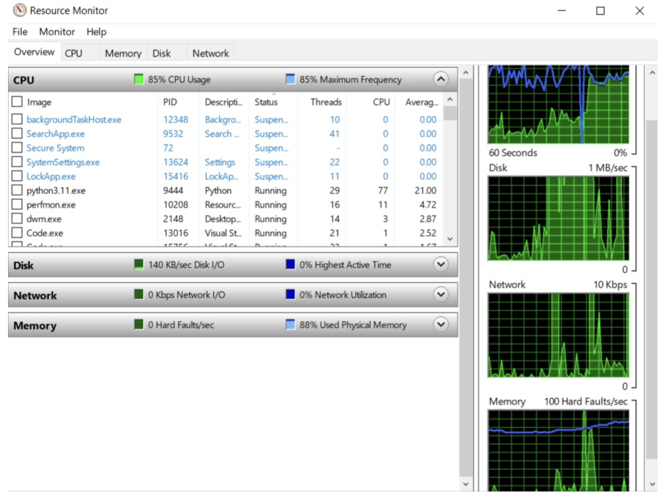
Performance of yolov8 on a pc

